Slide 1
PV Access
Oct. 2018
Kay Kasemir
Python examples by Amanda Carpenter

Slide 2
History
Channel Access
DBR_*: Numbers, enums, string, scalar and array, with time, alarm, limits
Since beginning of EPICS
Still fully supported
PV Access
PV Data: Arbitrary structures
Started as “EPICS V4” development
Since EPICS 7 (Dec. 2017) included in EPICS base

Slide 3
PV Access
Fundamentally similar to Channel Access
Name search via UDP
Connection for data transfer via TCP
EPICS_PVA_ADDR_LIST, EPICS_PVA_AUTO_ADDR_LIST
Get, put, monitor
Plus an ‘RPC’ type operation
Arbitrary PV Data structures instead of DBR_.. types

Slide 4
Custom Data: Great, but then what?
structure: short level double data string type time stamp …
structure: short level double wert string typ long zeit …
structure: double value short status short severity string units time timeStamp …
Which number to show on a user display?
What units?
Is this an alarm?
Time stamp?
structure: short info double content string meta long ms …

Slide 5
“Normative Types”
Channel Access
struct dbr_ctrl_double: short status short severity short precision char units[8] … no timestamp … double value struct dbr_time_double: short status short severity timestamp stamp double value
You get what you request (network always transfers complete struct)
PV Access
epics:nt/NTScalar: double value short status short severity string units time timeStamp …
You get what you request (but network only transfers changes)

Slide 6
Channel Access vs. PV Access
EPICS 7 IOCs include PVA server Similar command line tools:
cainfo training:ai1
caget training:ai1
camonitor training:ai1
caget –d CTRL_DOUBLE training:ai
caget training:ai1.SCAN
pvinfo training:ai1
pvget training:ai1
pvget –m training:ai1
pvget -r 'field()' training:ai1
pvget training:ai1.SCAN

Slide 7
CS-Studio: Use ‘pva://…’

Slide 8
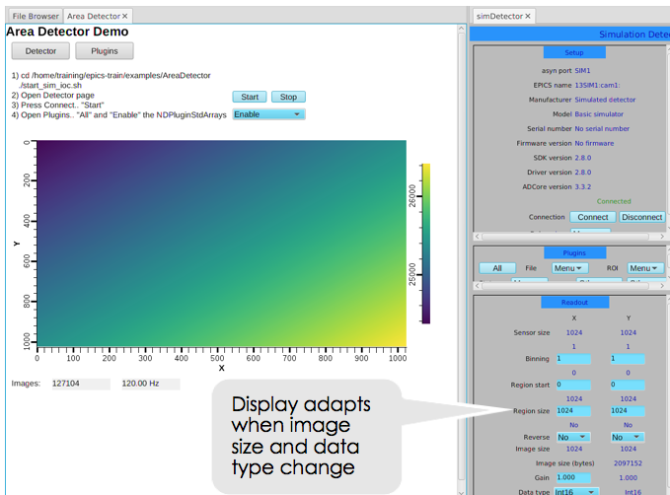
Images: Normative type NTNDArray
Served by Area Detector (NDPluginPVA) or ‘start_imagedemo’
pvinfo IMAGE
Value, dimensions, codec
CS-Studio: Image widget
Only needs pva://IMAGE

Slide 9
Custom PV Data
SNS Beam Lines started to use this in ~2014
start_neutrondemo
pvinfo neutrons
Allows fetching just what’s needed:
# For detector pixel display pvget -r 'field(pixel)' neutrons pvget –m -r 'field(timeStamp, pixel)' neutrons
# For energy displays pvget –m -r 'field(time_of_flight, pixel)' neutrons

Slide 10
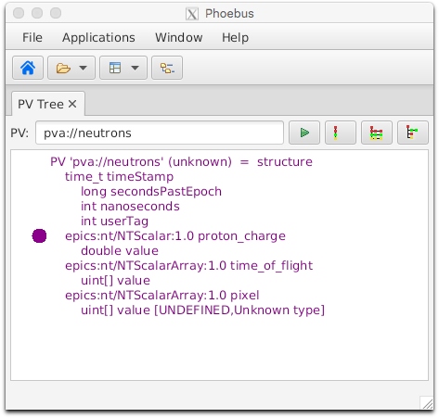
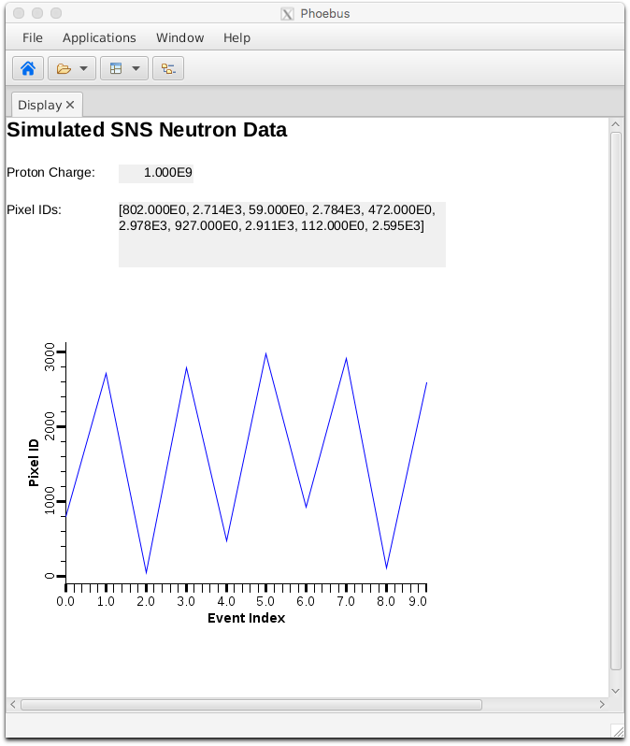
Custom PV Data in CS-Studio
Cannot handle arbitrary structure
pva://neutrons
Can handle fields which are scalar or array
pva://neutrons/proton_charge
pva://neutrons/pixel

Slide 11
PV Access and Python
Basic ‘get’
cd ~/epics-train/examples/python/
python example1.py
‘monitor’
python example2.py

Slide 12
PV Access API with Channel Access as “Provider”
PV Access supports both the actual PvAccess protocol but also Channel Access.
New tools, written for PVA, can thus fall back to CA:
python example3.py
Tools like CS-Studio can use both ca:// and pva://, so multiple transition options.

Slide 13
Custom PV Data in Python Client
Python receives data as dictionary, access to any element
python neutrons.py

Slide 14
Custom PV Data from Python Server
Surprisingly easy:
# Server
python server.py
# Client
pvinfo pair
pvget -m -r "x, y" pair
pv = PvObject({'x': INT, 'y' : INT})
server = PvaServer('pair', pv)
x = 1
while True:
pv['x'] = x
pv['y'] = 2*x
server.update(pv)
sleep(1)
x = x + 1

Slide 15
More Examples
Display Builder pva_server_ramp
Python code that serves ‘pva://ramp’ with alarm, prec, timestamp, …
Display Builder table_server
Python code that serves ‘pva://table’ as “NTTable”
Not practical to replace regular IOCs with python, but useful when custom data is needed

Slide 16
Custom PV Data from IOC Records
`makeBaseApp.pl –t example` includes “group”, see ~/epics-train/examples/ExampleApp/Db/circle.db
Calc records ..:circle:x & ..:circle:y compute (x, y) coordinate on circle
info() annotations create PV ”training:circle” PV as struct { angle, x, y }
PVA “training:circle” updates atomically
camonitor training:x training:y receives separate x, y updates pvget –m training:circle will always see sqrt(x²+y²)==1
cd ~/epics-train/examples/python python circle.py

Slide 17
PV Access
Update to Channel Access
Both can be used in parallel
Similar, but supports custom data types
Won’t replace IOC, but useful for special cases
Since EPICS 7 included in base
Details of ‘group’, PVA gateway, ‘field(…)’ access still evolving

